Slide 1
TRANSFORMATIONS IN OPEN GL
INSTRUCTOR: Sabina Irum

Slide 2
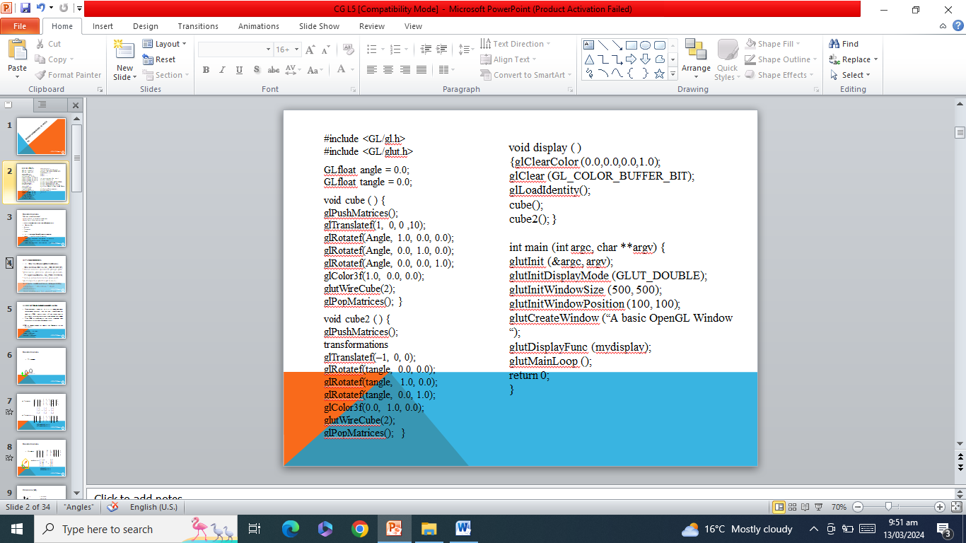
#include <GL/gl.h>
#include <GL/glut.h>
GLfloat angle = 0.0;
GLfloat tangle = 0.0;
void cube ( ) {
glPushMatrices();
glTranslatef(1, 0, 0 ,10);
glRotatef(Angle, 1.0, 0.0, 0.0);
glRotatef(Angles, 0.0, 1.0, 0.0);
glColor3f(1.0, 0.0, 0.0);
glutWireCube(2);
glPop(); }
void cube2 ( ) {
glPushMatrices();
transformations
glTranslatef(–1, 0, 0);
glRotatef(tangle, 0.0, 0.0);
glColor3f(0.0, 1.0, 0.0);
glutWireCube(2);
glPopMatrices(); }
void display ( )
{glClearColor (0.0,0.0,0.0,1.0);
glClear (GL_COLOR_BUFFER_BIT);
glLoadIdentity();
cube();
cube2(); }
int main (int argc, char **argv) {
glutInit (&argc, argv);
glutInitDisplayMode (GLUT_DOUBLE);
glutInitWindowSize (500, 500);
glutInitWindowPosition (100, 100);
glutCreateWindow (“A basic OpenGL Window“);
glutDisplayFunc (mydisplaYY);
glutMainLoop ();
return 0;
}

Slide 3
Transformations
Why use transformations?
  Create object in convenient coordinates
  Reuse basic shape multiple times
Learn how to carry out transformations in
OpenGL
  - Rotation
  - Translation
  - Scaling
• Introduce OpenGL matrix modes
  Viewing transformation(Projection)
    Used for positioning and aiming a camera.
  Modeling transformation.(Model-view)
    Used for positioning and orienting the model.
INSTRUCTOR: Sabina Irum

Slide 4
OPENGL MATRICES
• Matrix Mode(glMatrixMode)
ModelViewMatrix (GL_MODELVIEW)
  Model related operations: glBegin, glEnd,
  glTranslate, glRotate, glScale, gluLookAt…
Projection Matrix (GL_PROJECTION)
  Setup projection matrix: glViewport,
  gluPerspective/glOrtho/glFrustum…
Screen coordinates is computed by
  Projection * ModelView * object coordinates
  Then normalized for viewport size
INSTRUCTOR: Sabina Irum

Slide 5
CURRENT TRANSFORMATION MATRIX (CTM)
Conceptually there is a 4 x 4 homogeneous coordinate matrix, the current transformation matrix (CTM) that is part of the state and is applied to all vertices that pass down the pipeline
The CTM is defined in the user program and loaded into a transformation unit
CTM is manipulated by doing the following to the object.
  Translating the object.
  Scaling the object.
  Rotating the object.
INSTRUCTOR: Sabina Irum

Slide 6

Transformations
Translation
INSTRUCTOR: Sabina Irum

Slide 7
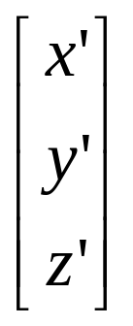
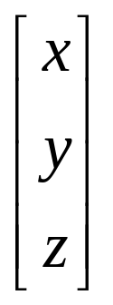
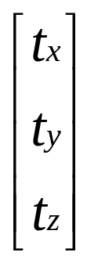
Translation:
Translate(a,b,c)
x’ 1 0 0 tx x
y’ = 0 1 0 ty * y
Z’ 0 0 1 tz z
1 0 0 0 1 1
=
+
x’ 1 0 0 a x
y’ = 0 1 0 b * y
Z’ 0 0 1 c z
1 0 0 0 1 1
glTranslatef(a,b,c);
glTranslated(a,b,c);
INSTRUCTOR: Sabina Irum

Slide 8
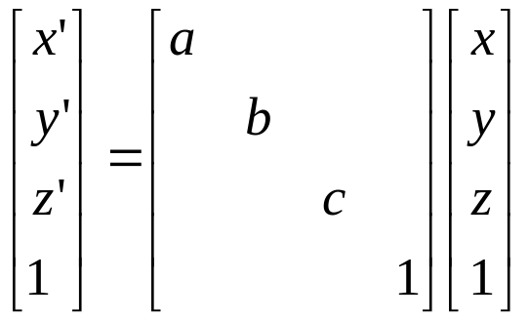
Transformations
x’ Sx 0 0 0 x
y’ = 0 Sy 0 0 * y
Z’ 0 0 Sz 0 z
1 0 0 0 1 1
Scaling
scale(a,b,c)
glScalef(a,b,c);
glScaled(a,b,c);
INSTRUCTOR: Sabina Irum

Slide 9


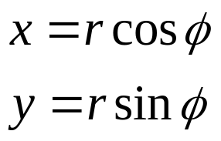

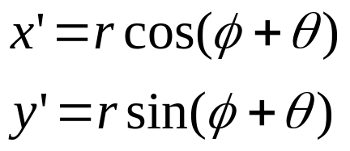



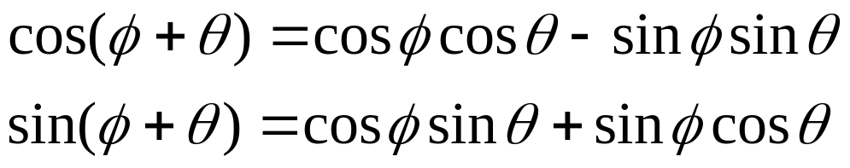
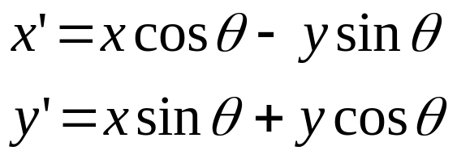
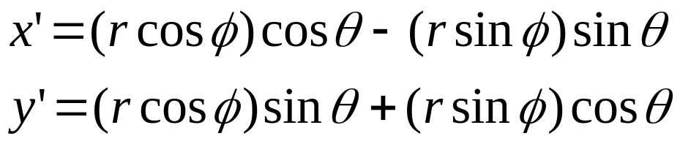
Rotations (2D)
INSTRUCTOR: Sabina Irum

Slide 10
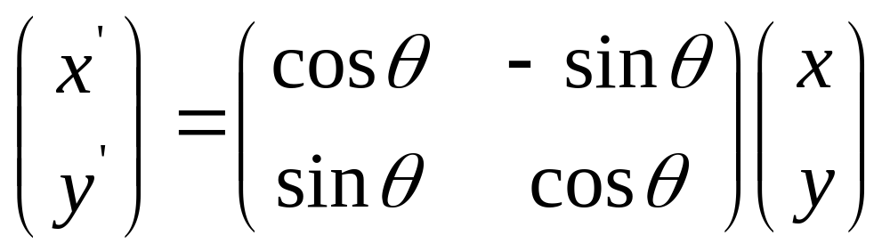
Rotations 2D
So in matrix notation
INSTRUCTOR: Sabina Irum

Slide 11
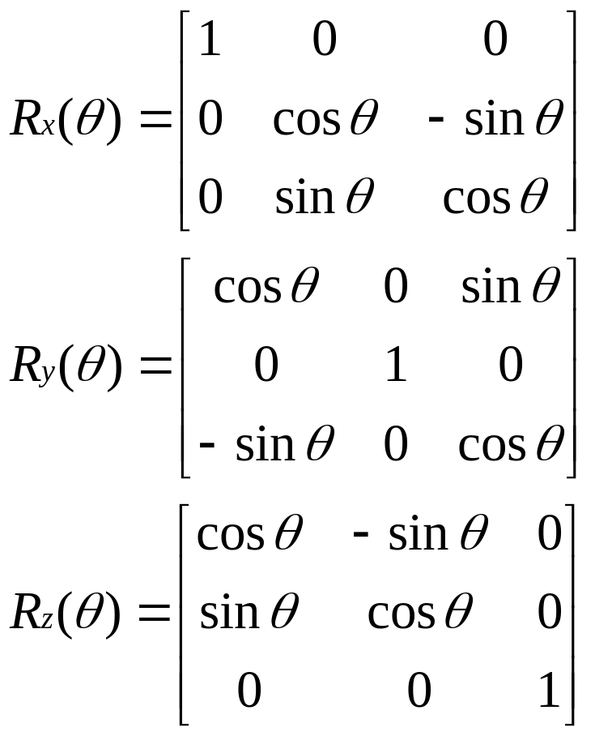
Rotations (2D)
INSTRUCTOR: Sabina Irum

Slide 12
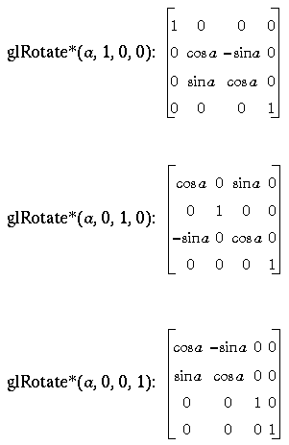
OPENGL ROTATION MATRIX
x’ x
y’ = M * y
Z’ z
1 1
INSTRUCTOR: Sabina Irum

Slide 13
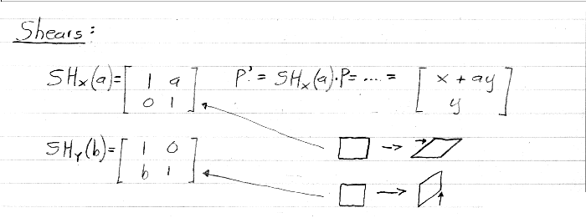
2D transformations
INSTRUCTOR: Sabina Irum
© Marc Levoy

Slide 14


Combining Translation & Rotation
INSTRUCTOR: Sabina Irum

Slide 15
Example Revisit
We want rotation and then translation
Generate wrong results if you do:
  glRotated(60,0,0,1);
  glTranslated(5,0,0);
  glBegin()
glTranslated(5,0,0);
glRotate(60,0,0,1);
glBegin()
…
You need to specify the transformation
in the opposite order!!
INSTRUCTOR: Sabina Irum

Slide 16
HOW STRANGE …
OpenGL has its reason …
It wants you to think of transformation in a different way.
Instead of thinking of transform the object in a fixed global coordinate system,
  you should think of transforming an object as moving (transforming) its local coordinate system.
INSTRUCTOR: Sabina Irum

Slide 17
OpenGL Transformation
When using OpenGL, we need to think of object transformations as moving (transforming) an object’s local coordinate frame.
All the transformations are performed relative to the current coordinate frame origin and axes.
INSTRUCTOR: Sabina Irum

Slide 18
Translate Coordinate Frame
Translate (3,3)?
INSTRUCTOR: Sabina Irum

Slide 19
Translate Coordinate Frame (2)
Translate (3,3)?
INSTRUCTOR: Sabina Irum

Slide 20
Rotate Coordinate Frame
Rotate 30 degree?
30 degree
INSTRUCTOR: Sabina Irum

Slide 21
Scale Coordinate Frame
Scale (0.5,0.5)?
INSTRUCTOR: Sabina Irum

Slide 22
Compose Transformations
Transformations?
Answer:
Translate(7,9)
Rotate 45
Scale (2,2)
o
45
(7,9)
INSTRUCTOR: Sabina Irum

Slide 23
Another example
How do you transform from C1 to C2?
C1
C2
Translate (5,5) and then Rotate (60)
OR
Rotate (60) and then Translate (5,5) ???
60
o
(5,5)
Answer: Translate(5,5) and then
Rotate (60)
INSTRUCTOR: Sabina Irum

Slide 24
Another example (cont’d)
If you Rotate(60) and then Translate(5,5) …
60
o
C1
C2
5
5
60
o
You will be translated (5,5)
relative to C2!!
INSTRUCTOR: Sabina Irum

Slide 25
Transform Objects
Does coordinate frame transformation have anything to do with object transformation?
  Yes,
    you can view transformation as paste the object to a local coordinate frame
    and move that coordinate frame.
INSTRUCTOR: Sabina Irum

Slide 26
Example
Old way: Transformation as moving
the object relative to the origin of a
global world coordinate frame.
o
60
o
Rotate ( )
Translate (5,0)
60
(5,0)
INSTRUCTOR: Sabina Irum

Slide 27
Example (cont’d)
If you think of transformations as
moving the local coordinate frame.
o
Translate (5,0)
2) Rotate ( )
60
o
60
(5,0)
Exact the opposite order compared to the
previous slide!!
INSTRUCTOR: Sabina Irum

Slide 28
Put it all together
When you use OpenGL …
Think of transformation as moving coordinate frames.
Call OpenGL transformation functions in that order.
OpenGL will actually perform the transformations in the reverse order.
Everything will be just right!!!
INSTRUCTOR: Sabina Irum

Slide 29
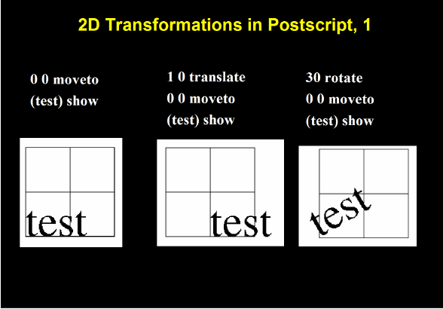
INSTRUCTOR: Sabina Irum

Slide 30
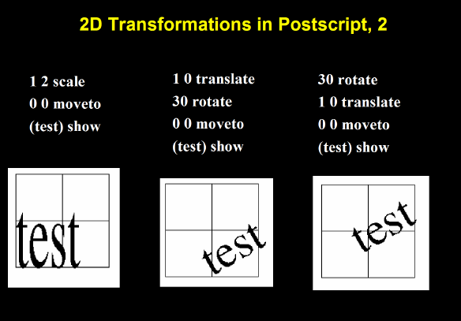
INSTRUCTOR: Sabina Irum

Slide 31
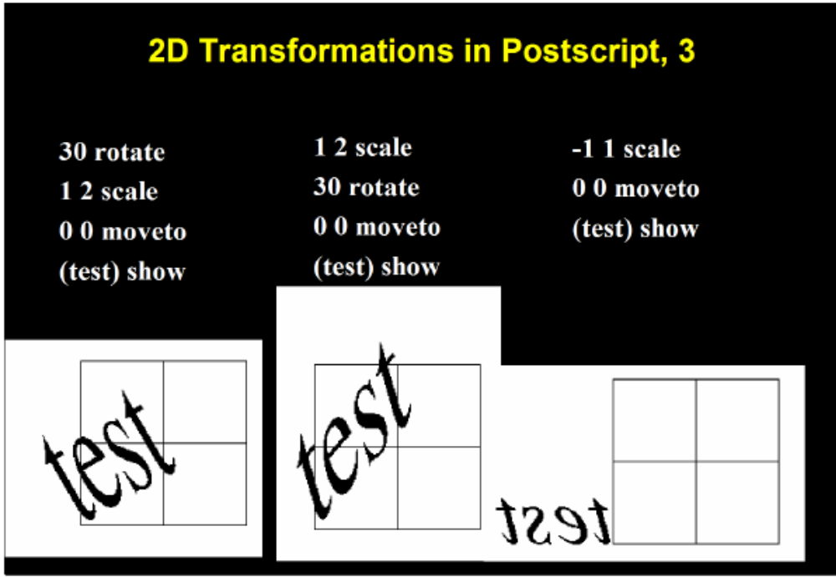
INSTRUCTOR: Sabina Irum

Slide 32
SUMMARIZING TRANSFORMATIONS
Translation
  glTranslatef(dx, dy, dz)
  can be used to shift an object in space
Rotation
  glRotatef(theta, vx, vy, vz);
  Note that theta is in degrees, and (vx, vy, vz) define the axis of rotation
scaling
  glScalef( sx, sy, sz)
Each has a float (f) and double (d) format (e.g., glScaled)
INSTRUCTOR: Sabina Irum

Slide 33
OPENGL STACK MATRIX
PUSH AND POP MATRIX STACK
glTranslate(5,0,0)
Draw_base();
glPushMatrix();
glRotate(75, 0,1,0);
Draw_left_hammer();
glPopMatrix();
glRotate(-75, 0,1,0);
Draw_right_hammer();
INSTRUCTOR: Sabina Irum

Slide 34
Example (cont’d)
(0,0)
(5,0)
INSTRUCTOR: Sabina Irum

